Slide 1
CS6360.004 Final Project Presentation On Airline Reservation System
By :-
Shobhit Agarwal - sxa138130
Kunal Arora - kxa142230
Indervir Singh - isb140030
Bala Yadav - bxy140430

Slide 2
Introduction
Airline Reservation System is one of the most used database system in the world
These systems can be generally categorized as multi-user Transaction Processing Systems
Transaction Processing Systems are system with large databases and where hundreds of concurrent users are executing database transactions
These systems require high availability and fast response time for hundreds of concurrent users

Slide 3
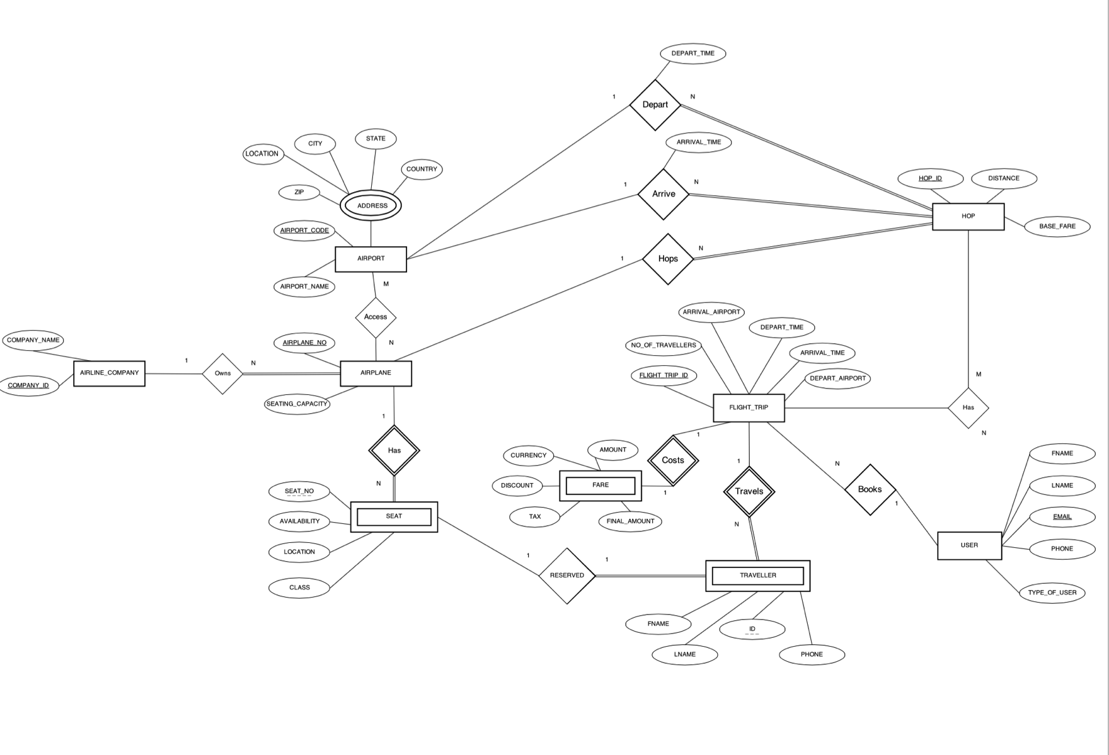
ER Diagram

Slide 4
Assumptions
An airline company can own many airplanes, but no airplanes can be without an airline company.
Address is a multi-value attribute
Multiple airplanes can land on an airport and also multiple airports can handle multiple airplanes
An airplane-seat cannot exists without an airplane
A single seat will be reserved for a single traveller
A traveller can have multiple flight trips and there is no traveller without a flight trip i.e. if there is no flight trip, there wont be any traveller for it

Slide 5
Assumptions
Fare exists only if there is a flight trip i.e. if there is no flight trip, there wont be a cost for it
A user can book multiple flight trips
A flight trip can have multiple hops and a particular hop can be used by multiple flight trips

Slide 6
Some Important Terms
HOP: A hop can be understood as a trip between two immediate locations in a complete flight trip without any layover.
Flight Trip: A flight trip is one complete journey including the hops
Example: If we are travelling from city A to city C via city B; A→B will be one HOP and B→ C will be another HOP but the complete journey from A→ C will be one flight trip.

Slide 7
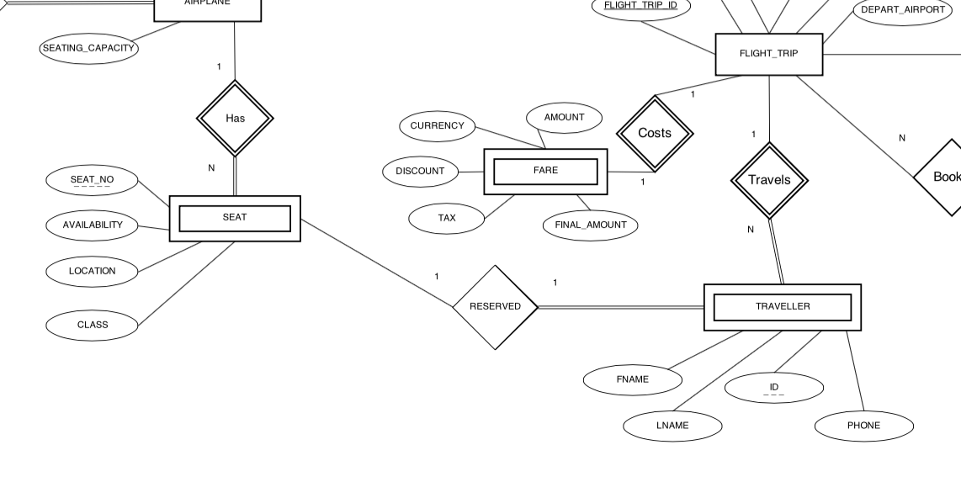
one-to-one binary relationships
SEAT-reserved-TRAVELLER
FLIGHT_TRIP - costs - FARE

Slide 8
one-to-many binary relationships
AIRLINE_COMPANY - owns - AIRPLANE
AIRPLANE - has - SEATS
FLIGHT_TRIP - travels - TRAVELLER
USER - books - FLIGHT_TRIP
AIRPLANE - hops - HOP
AIRPORT - arrive - HOP
AIRPORT - depart - HOP

Slide 9
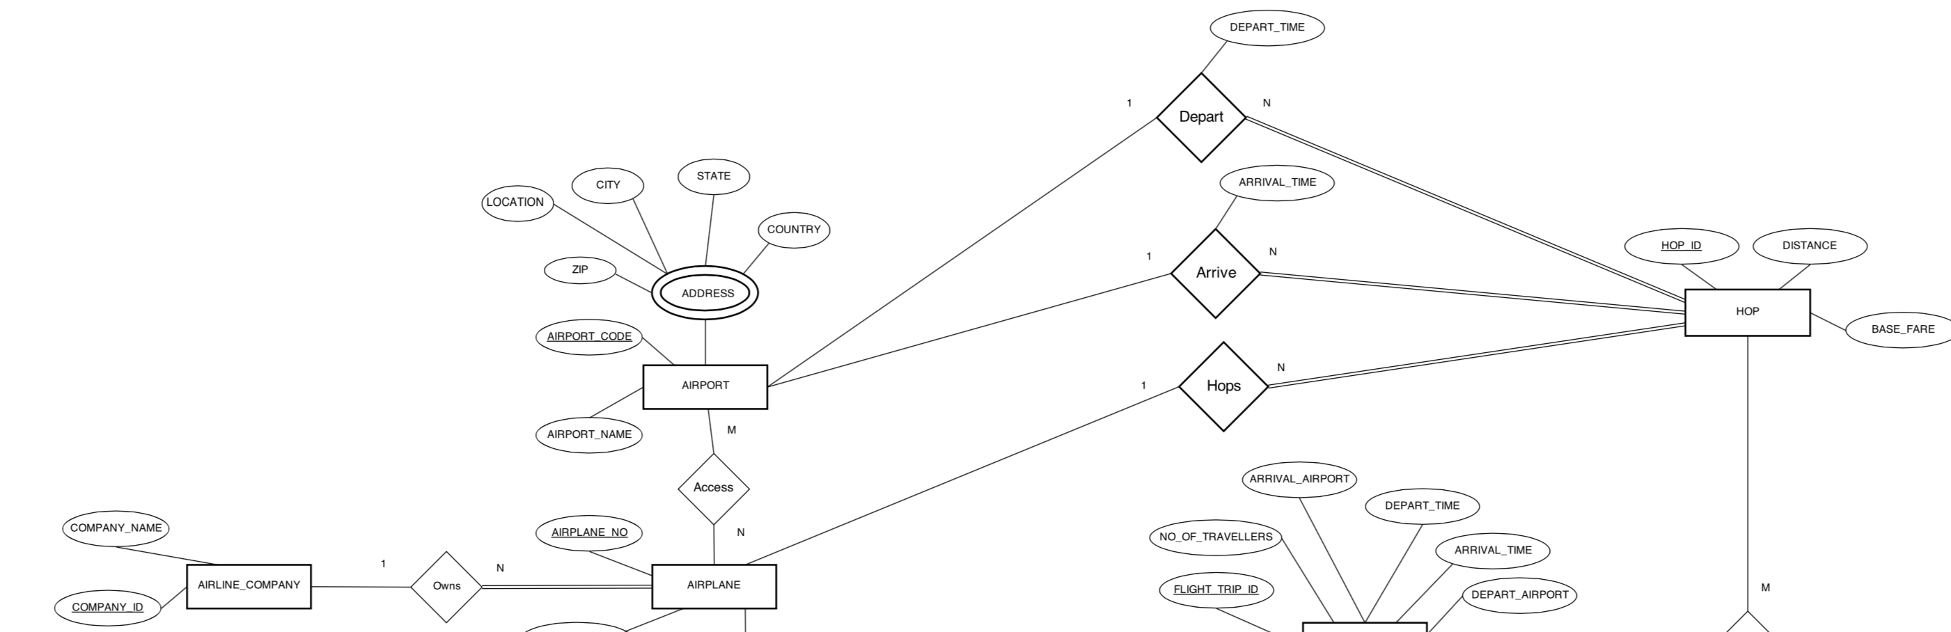
one-to-many binary relationships

Slide 10
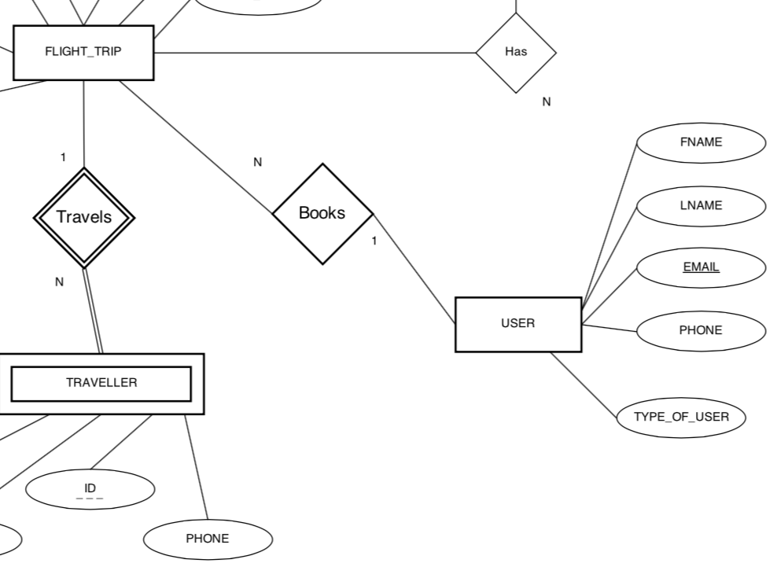
one-to-many binary relationships

Slide 11
many-to-many binary relationships
AIRPORT - access - AIRPLANE
FLIGHT_TRIP - has - HOP

Slide 12
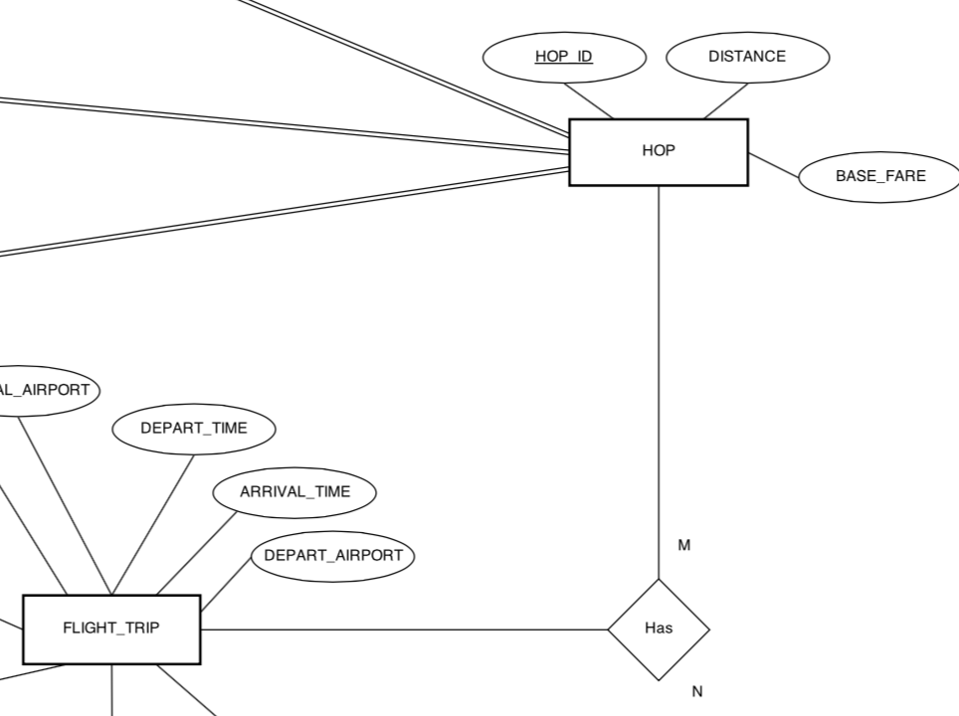
many-to-many binary relationships

Slide 13
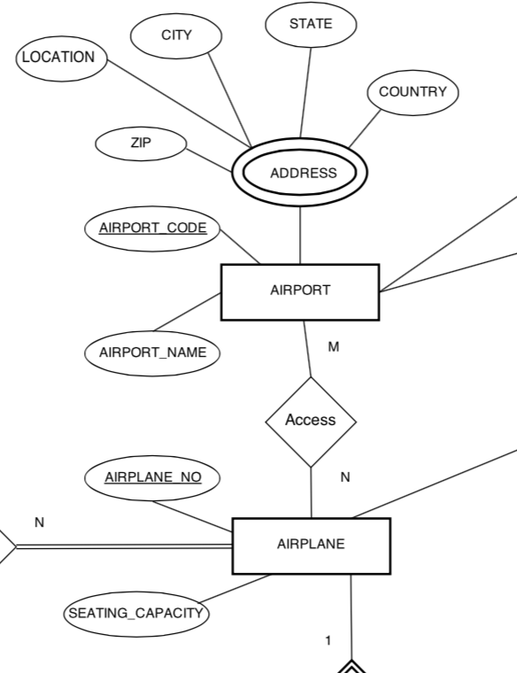
many-to-many binary relationships

Slide 14
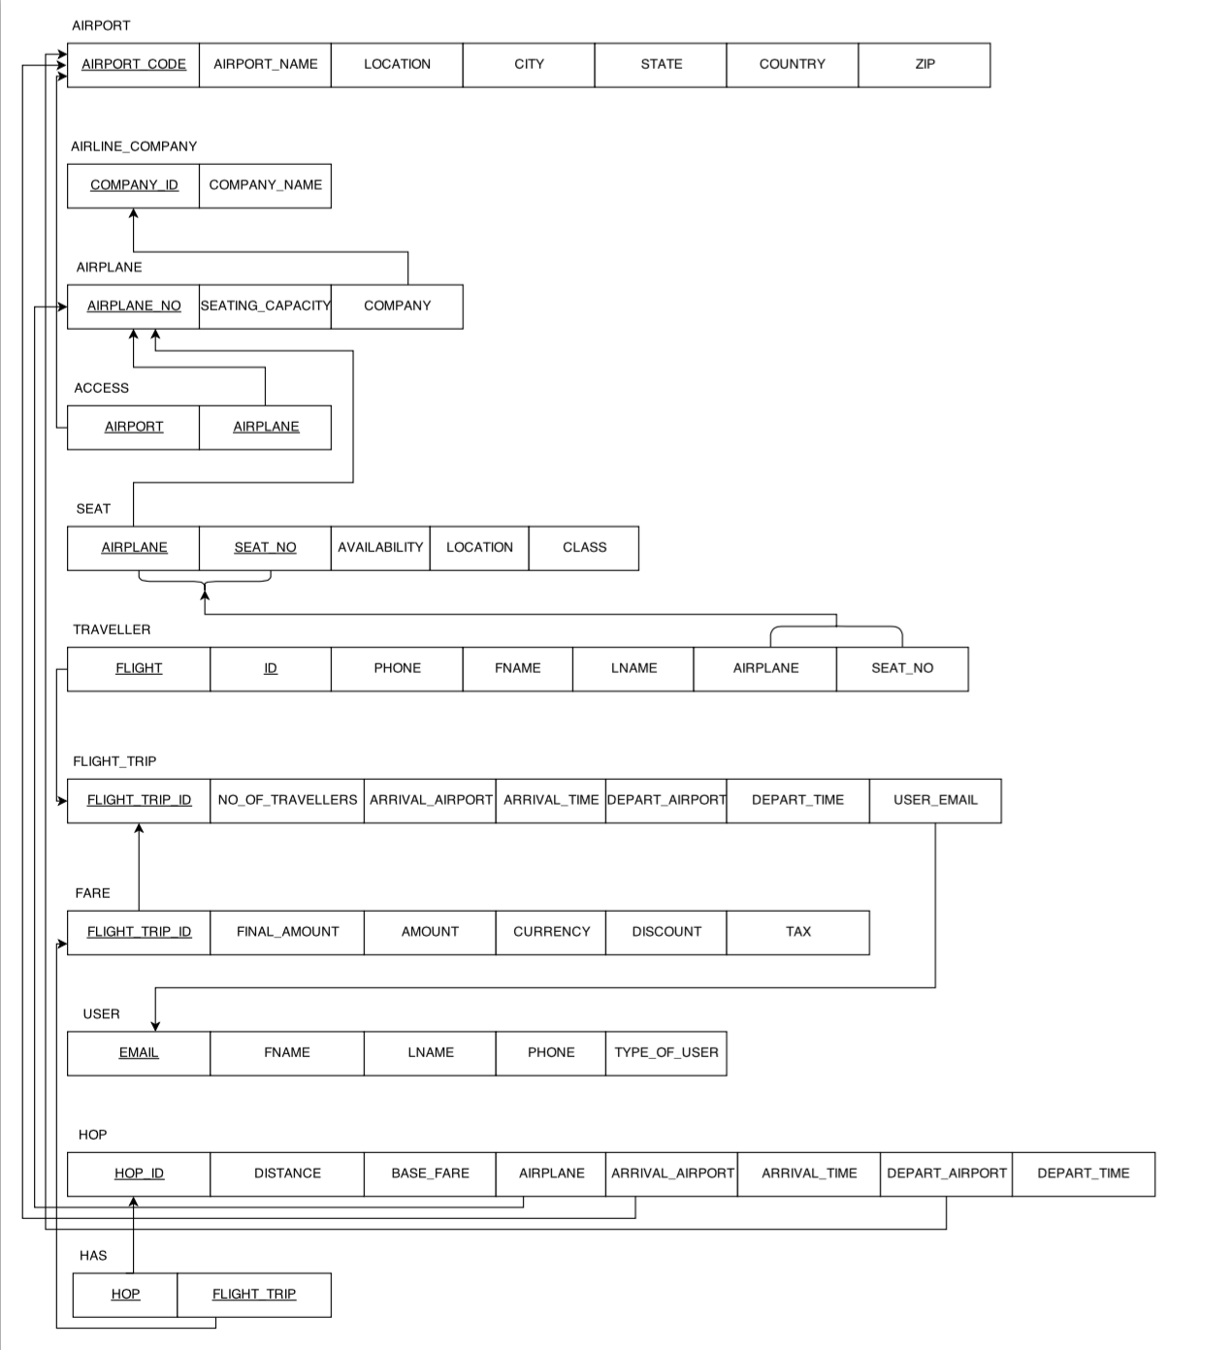
Relational Schema

Slide 15
Tables &Primary Keys
AIRPORT - Airport_Code
AIRLINE_COMPANY - Company_ID
AIRPLANE - Airplane_no
ACCESS - Airplane, Airport
SEAT - Airplane, Seat_no
TRAVELLER - Flight, ID
FLIGHT_TRIP - Flight_trip_id
FARE - Flight_trip_id
USER - Email
HOP - Hop_id
HAS (HOP) - Hop, Flight_trip

